Slide 1
Basics of Information System Design
Notes:
Lecture# 02
July 26. 2007
IT60105: D Samanta, SIT, IIT Kharagpur

Slide 2
What is a System?
A collection of parts that work together to achieve a goal/task
  Examples; Solar system, Digestive systems, Computer system, Information system etc.
A set of objects and relationships among the objects viewed as a whole and designed to achieve a purpose
Information System Design

Slide 3
What is subsystem?
A subsystem is simply a system within a system.
  Automobile is a system composed of subsystems: Engine system, Body system, Frame system
Each of these subsystem is composed of sub-sub --systems.
  Engine system: carburetor system, generator system, fuel system, and so on.
Information System Design

Slide 4
System Concepts
Decomposition
  The process of breaking down a system into smaller components
  Allows the systems analyst to:
  Break a system into small, manageable subsystems
  Focus on one area at a time
  Concentrate on component pertinent to one group of users
  Build different components at independent times
Modularity
  Process of dividing a system into modules of a relatively uniform size and Modules simplify system design
Coupling
  Subsystems that are dependent upon each other are coupled
Cohesion
  Extent to which a subsystem performs a single
Information System Design

Slide 5
CBIS vs Manual Systems
CBIS
  Information system that rely on computer hardware and software for processing and disseminating information
Manual systems
  Use paper + pencil technology
Information System Design

Slide 6
Approach to system development
There are three strategies of IS development
Process-oriented approach -An strategy to IS development that focuses on how and when data are moved through and changed by an IS.
Data-oriented approach- An strategy to IS development that focuses on the ideal organization of data rather than where and how data are used.
Object-oriented approach- A system development methodologies and techniques based on objects rather than data or process.
Information System Design

Slide 7
What is an Information System?
Information
+
System
=
Information System
Information System Design
Notes:
Lecture# 02
July 26. 2007
IT60105: D Samanta, SIT, IIT Kharagpur

Slide 8
Definition of Information
Information?
=
Creating data
Collecting data
Managing data
Processing data
Information System Design
Notes:
Lecture# 02
July 26. 2007
IT60105: D Samanta, SIT, IIT Kharagpur

Slide 9
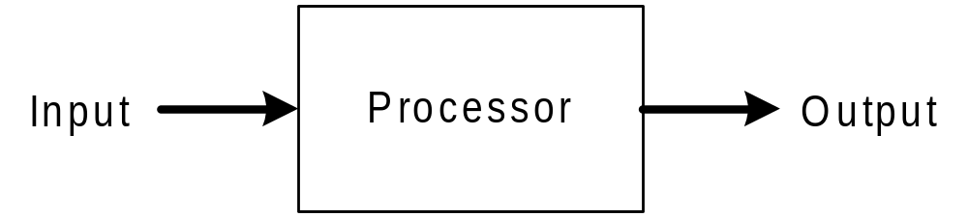
Definition of Information
System?
=
Information System Design
Notes:
Lecture# 02
July 26. 2007
IT60105: D Samanta, SIT, IIT Kharagpur

Slide 10
What is an Information System?
An Information System is a combination of
  Hardware
  Software
  Telecommunication networks (Internet)
Which people build and use to
  Collect
  Create
  Distribute data
Typically in
  Organizational setting
Information System Design
Notes:
Lecture# 02
July 26. 2007
IT60105: D Samanta, SIT, IIT Kharagpur

Slide 11
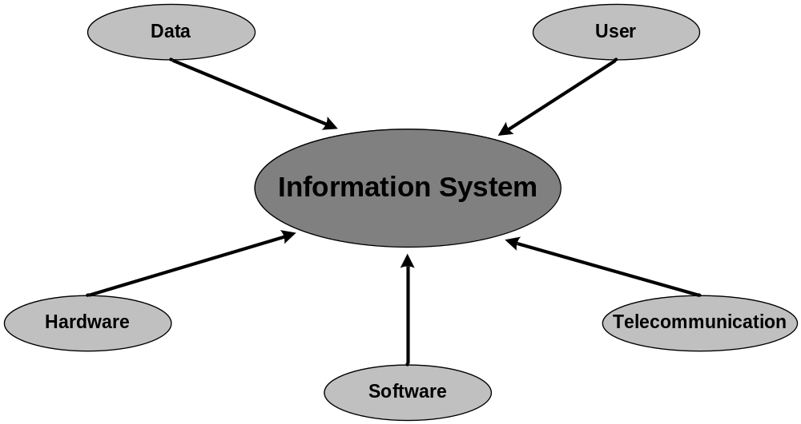
Components of an Information System
Information System Design
Notes:
Lecture# 02
July 26. 2007
IT60105: D Samanta, SIT, IIT Kharagpur

Slide 12
Example of Information Systems
Library Information System
Information retrieval system
Geographical Information System
On-line Business Transaction
Microsoft Office
www.scs.dauniv.ac.in
MatLab
Information System Design
Notes:
Lecture# 02
July 26. 2007
IT60105: D Samanta, SIT, IIT Kharagpur

Slide 13
Information System Types
Transaction Processing Systems (TPS)
Management Information Systems (MIS)
Decision Support Systems (DSS)
Expert System and Artificial Intelligence (ES &AI)
Information System Design

Slide 14
Transaction Processing Systems (TPS)
TPS are computerized information systems that were developed to process large amounts of data for routine business transaction.
Automate the handling of data about business activities and transactions, which can be thought of a simple discrete events in the life of an organization
  Data about each transaction are captured,
  Transactions are verified and accepted/rejected,
  Validation transactions are stored for later aggregation.
  Report may be produced to provide summarization of the transactions, and
  Transaction may be moved from process to process in order to handle all aspects of the business activities.
Information System Design

Slide 15
Management Information Systems (MIS)
Information system at the management level of an organization that serves the functions of planning, controlling, and decision making by providing routine summary and exception reports.
It takes the relatively raw data available through a TPS and converts them into a meaningful aggregated form that mangers need to conduct their responsibilities.
Developing an MIS calls for a good understanding of what kind of information managers require and how managers use information in their jobs.
Information System Design

Slide 16
Decision Support systems (DSS)
Information system at the management level of an organization that combines data and sophisticated analytical models or data analysis tools to support semi-structured and unstructured decision making.
DSS are designed to help organizational decision make decision.
A DSS is composed of a:
  Database ( may be extracted from a TPS/MIS)
  Graphical/mathematical models for business process
  User interface that provides a way to communicate with DSS
Information System Design

Slide 17
Expert System and Artificial Intelligence
Knowledge representation describes the way an expert would approach the problem. It attempts to codify and manipulate knowledge rather than information.
User communication with an ES via an interactive dialogue.
The ES asks questions ( that an expert would ask) and the end user
supplies the answers.
The answers are then used to determine which rules apply and the ES provides a recommendation based on the rule.
Knowledge Engineers perform knowledge acquisition; they are similar with system analyst but are trained to use different techniques.
Information System Design

Slide 18
Exercises
Identify the different components in the following systems: Library Information System, Microsoft Office, Cellular Phone.
Identify systems, which are not information system?
Describe the various types of Information Systems along with their merits and demerits.
Explain the applications of each category of information systems?
Information System Design
Notes:
Lecture# 02
July 26. 2007
IT60105: D Samanta, SIT, IIT Kharagpur

